Slide 1
Introduction to
Scientific Computing
Course : MATH6183 – Scientific Computing
Year : 2021

Slide 2
Outlines
Intro to Scientific Computing
Intro to Numerical Method
Absolute and relative errors

Slide 3
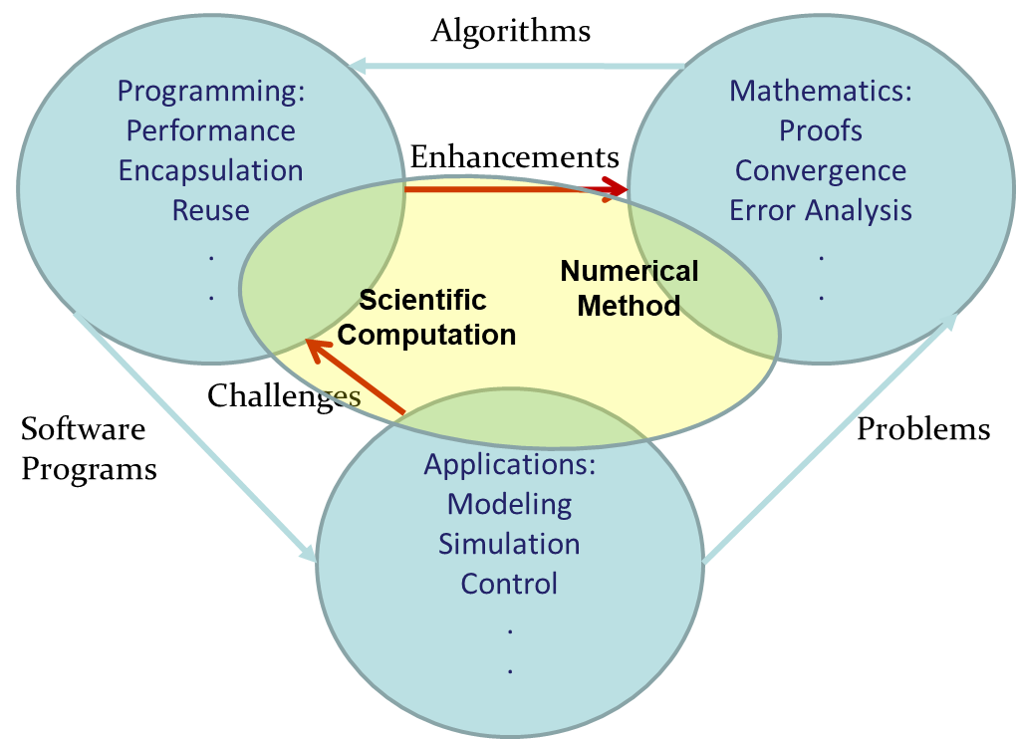
Course Philosophy

Slide 4
Scientific Computing
Scientific Computing is the collection of tools, techniques, and theories required to solve on a computer mathematical models of problems in Science and Engineering (Golub and Ortega, 1992).
A majority of these tools, techniques, and theories originally developed in Mathematics. many of founded long before the advent of electronic computers. This set is called Numerical Analysis (or Numerical Methods) and constitutes a major part of scientific computing.
Programming Language:
Fortran, MATLAB, Scilab, GNU-Octave, Mathematica, Python
Gene H. Golub and James M. Ortega. Scientific Computing and Differential Equations – An Introduction to Numerical Methods. Academic Press, 1992.

Slide 5

Scientific Computing
Why Python?
Free & Open source: science should be able to be accessed by everyone.
Serves both scientific and general purposes
Use a readable language and make your program greatly maintainable
Has many libraries: numpy, scipy, scikit-learn and matplotlib. Those libraries allow you to do everything you can do in Matlab by using Python.
Using Python in Google Colab instead of a plain Jupyter Notebook:
Accessed trough browser and saved on the Cloud
Pre-Installed Libraries: Pandas, NumPy, Matplotlib
Collaboration
Free GPU and TPU Use

Slide 6
Numerical Methods
Numerical methods, or numerical analysis are techniques by which mathematical problems are formulated so that they can be solved with arithmetic operations.
Numerical | Analytical
approximate | exact
more intuitive | less intuitive
easily coded | not so easy
easy to get | not so easy
Finds a solution | Finds the solution
May diverge | Always finds the solution
This course!! | Not in this course!!

Slide 7
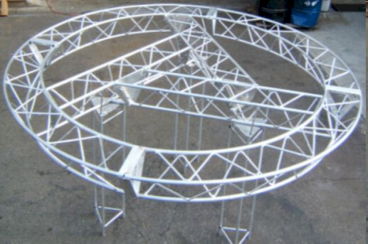
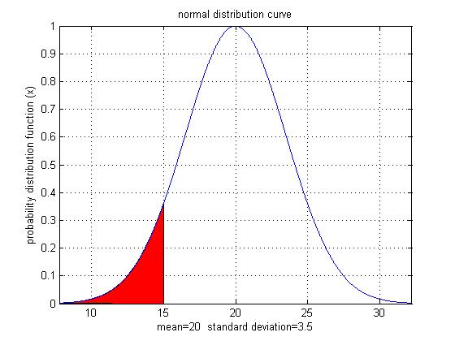
Numerical Methods
Why use Numerical methods ?
To solve problems that cannot be solved exactly (intractable)

Slide 8
Numerical Methods
We utilize numerical approximation of solutions to understood problems.
Two main objectives
Quantify Errors: Approximation without error estimation is useless
Increase Efficiency : Solutions which take years or need more resources that you have are useless
What can we solve numerically?
Systems of Linear Equations (*)
Regression and Interpolation (*)
Taylor Series
Root of Equations (*)
Numerical Differentiation (*)
Numerical Integration (*)
Ordinary Differential Equations (*)
…etc

Slide 9

Representation of Numbers
Base-N and Binary
You are familiar with the decimal system:
Decimal System: Base = 10 , Digits (0,1,…,9)
Standard representation
Normalized Floating Point Representation
Scientific Notation: Exactly one non-zero digit appears before decimal point.
Advantage: Efficient in representing very small or very large numbers.

Slide 10
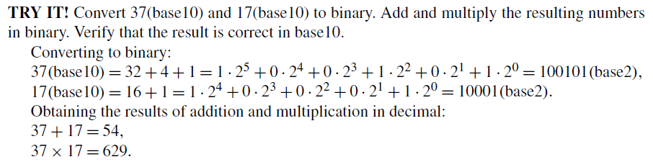
Representation of Numbers
Base-N and Binary
For computers, numbers are often represented in base 2 or binary numbers. The only available digits are 0 and 1, and each digit is the coefficient of a power of 2. Digits in a binary number are also known as bits. It is useful for computers because arithmetic operations on the digits 0 and 1 can be represented using AND, OR, and NOT, which can be computed quickly
Binary System
Base = 2, Digits {0.1}

Slide 11
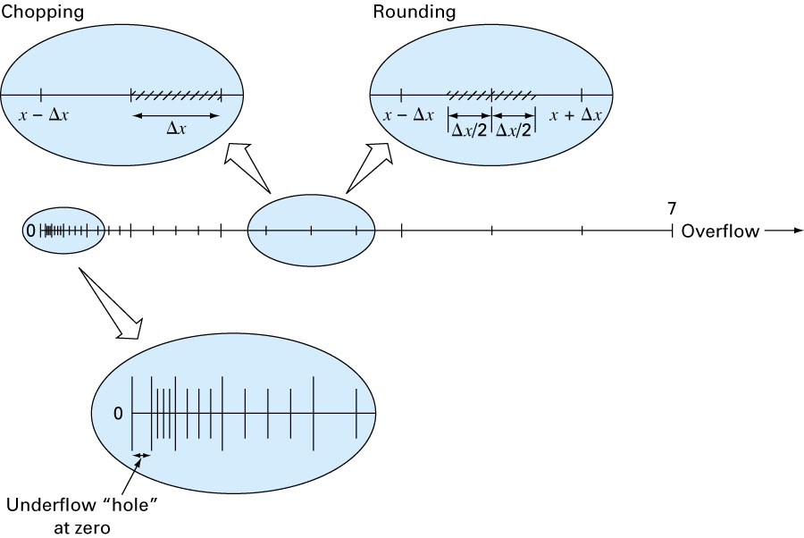
Rounding and Chopping
Rounding: Replace the number by the nearest machine number.
Chopping: Throw all extra digits.

Slide 12
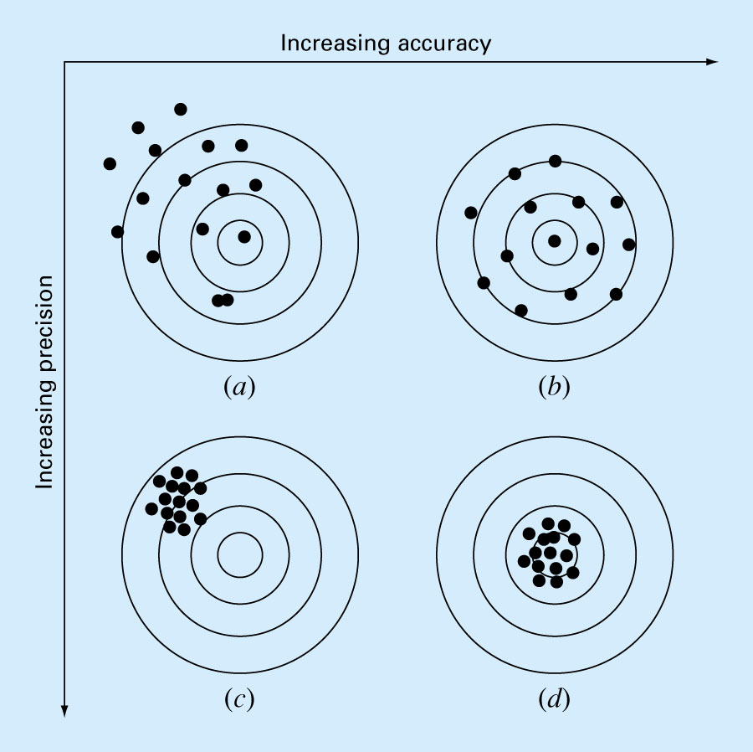
Accuracy and Precision
Accuracy is related to the closeness to the true value.
Precision is related to the closeness to other estimated values.

Slide 13
Error Definitions
Truncation errors result when approximations/ discretization are used to represent exact mathematical procedures. e.g. finite Taylor series
Round-off errors result when numbers having limited significant figures are used to represent exact numbers
Example:
We know that
Lets approximate the value of by 1.41421 (using only 5 decimal places). Then
Modeling Error Errors in deriving the mathematical equation or using a model that does not describe adequately the physical system under study. e.g Selecting a wrong algorithm
Round-off error

Slide 14
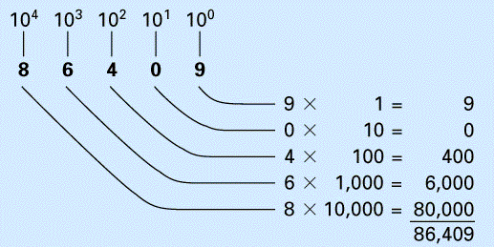
Round-off Errors
Round-off errors occur because computers retain only a fixed number of significant figures.
We use the decimal (base 10) system which uses the 10 digits 0, 1, …, 9.

Slide 15
True, Absolute, and Relative Error
The error is the difference between the true value and the approximation:
true error = E_{t} = true value – approximation
Absolute error = |E_{t}| = | true value – approximation |
Most of the time we will use what we call the true fractional relative error
Or we use the true percent relative error
ε_{t} =

Slide 16
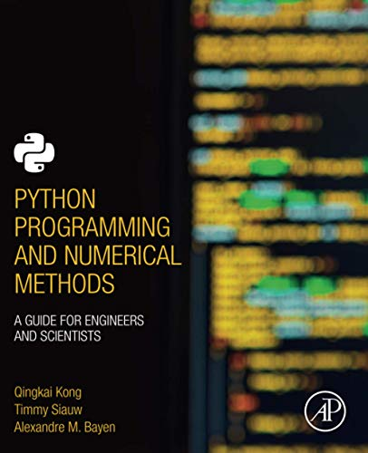
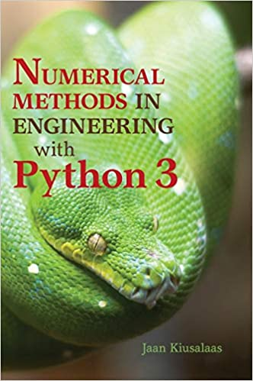
These slides have been adapted from: Kong, Q., Siauw, T., & Bayen, A. M. (2021). Python Programming and Numerical Methods: A Guide for Engineers and Scientists. Academic Press. ISBN: 978-0-12-819549-9 Kiusalaas, J. (2013). Numerical Methods in Engineering with Python 3. United Kingdom: Cambridge University Press. ISBN:9781107033856
Acknowledgement

